Slide 1
Water Supply and Water Quality Act of 2018

Slide 2
What is it?
$8.877 billion statewide water bond
November, 2018 ballot
Beneficial to conservation, environmental justice, agriculture, and fish and wildlife groups

Slide 3
How was the size of the water bond initiative determined?
Trend in water bonds:​
1996 Prop 204 $995 million​
2002 Prop 50 $3.4 billion​
2006 Prop 84 $5.4 billion​
2014 Prop 1 $7.12 billion​
(2016 Prop 51 Schools) $9 billion​
2018 water bond measure $8.877 billion​
​
Goal was to follow upward trend, slightly faster than inflation, but to stay below the successful school bond.

Slide 4
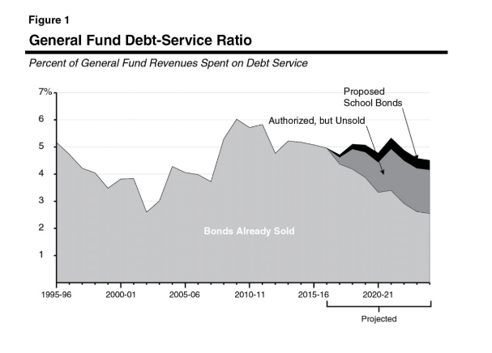
Fiscal Considerations

Slide 5
Summary of bill
Watershed Restoration - $2.355 billion
Fish and Waterfowl Habitat – $1.45 billion
Safe Drinking Water - $750 million
Urban Water Conservation - $300 million
Agricultural Water Conservation - $50 million
Wastewater Recycling - $400 million
Desalination of Groundwater - $400 million
Flood Management - $500 million
SGMA Compliance - $675 million
Flood Management – $500 million
Oroville Dam Repair - $200 million
Friant Kern Canal Repair - $750 million
Stormwater - $550 million

Slide 6
Conservation Funding by Agency
Wildlife Conservation Board - $1.3 billion
Coastal Conservancy - $475 million
Ocean Protection Council - $100 million
Natural Resources Agency - $270 million
Department of Parks and Recreation - $150 million
California Conservation Corps - $40 million
Other regional conservancies/restoration authorities - $1.3 billion

Slide 7
Types of relevant funding
- watershed restoration
- land acquisitions
- conservation and agricultural easements
- public recreation
- urban streams and forests
- fire protection and mitigation
- Conservation Corps activities
- fish/wildlife habitat

Slide 8
Relevant General Provisions
86151 (j) Indirect and overhead costs are grant eligible
86151 (g) Trust funds may be established for a number of programs
86158 (a) Planning, monitoring, and reporting costs are grant eligible
86159 - Repayment of finance is allowed
86165 (e) In-kind contributions up to twenty-five percent (25%) of the total project cost count as part of cost sharing, donated land qualifying
86165 (g) Use of the Natural Heritage Preservation Tax Credit Act of 2000 is allowed
86166 (a) Nonprofits are eligible agencies in nearly all programs

Slide 9
Endorsements
Conservation: California Native Plant Society, California Urban Streams Partnership, Tuolumne River Preservation Trust, California Watershed Network, Sierra Nevada Alliance, California Waterfowl Association, Sierra Fund
Environmental Justice: Community Water Center, Leadership Council for Justice and Accountability, Grassroots Ecology, The Watershed Project, Center for Sustainable Neighborhoods
Agriculture: California Dairy, California Fresh Fruit, California Pistachio Growers, California Rice Commission, Agricultural Council of California
Water Agencies: The Association of California Water Agencies (ACWA), Northern California Water Association (NCWA), Southern California Water Committee, numerous individual agencies
Other: Rural County Representatives of California, California Chamber of Commerce

Slide 10
Questions?
www.waterbond.org

